Slide 1
Intelligent Systems
CS4981 ML Production Systems
RJ Nowling

Slide 2
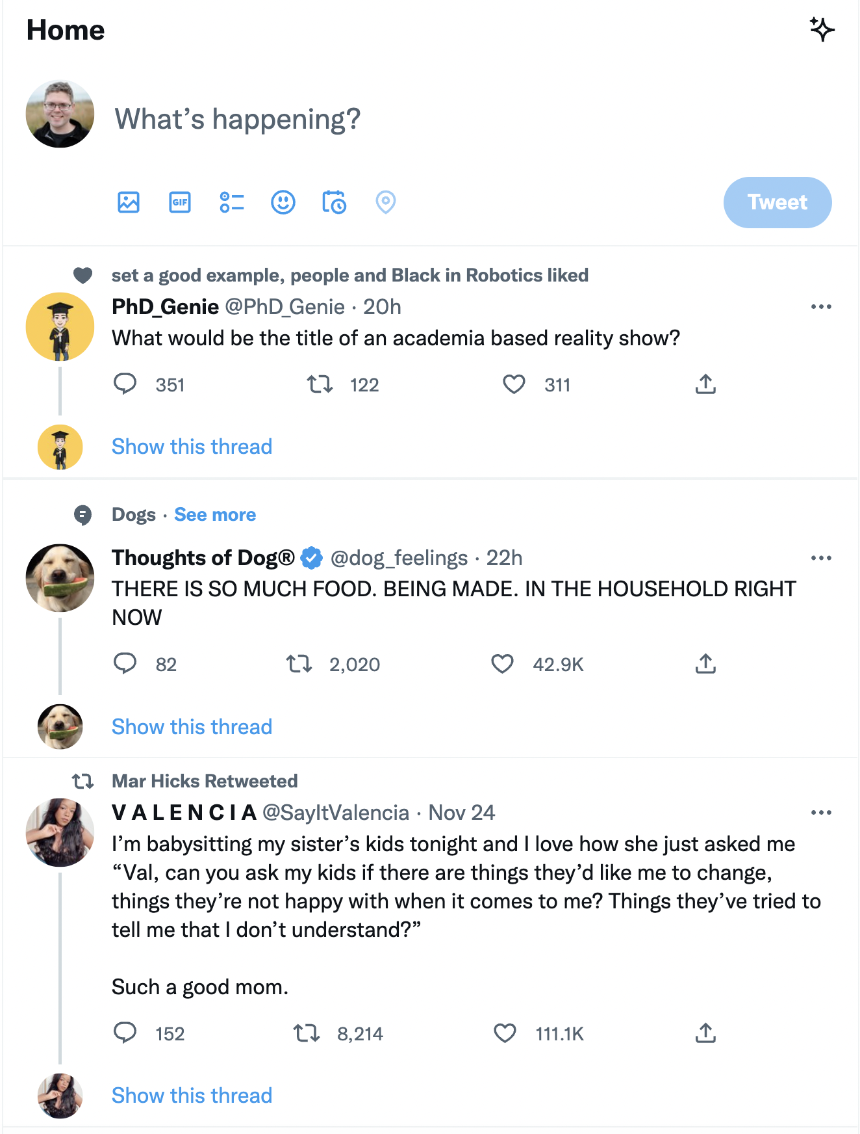
Social Media
User engagement important to retention
Revenue depends on ad impressions
Can't show ads if users aren't on the platform
More usage -> collect more data -> show more relevant ads
Users leave when bored or frustrated
Need to quickly and continually connect users to engaging content

Slide 3
Social Media
Filter, recommend "relevant" content – move away from purely chronological display
"Timelines" on Facebook
"What you missed" on Twitter
TikTok and YouTube recommendations

Slide 4

User-Generated Content
Twitter, TikTok, YouTube, etc. depend on user-generated content
By outsourcing content creation to users
It's free
Produced at massive scale
Use community gets to drive the latest trends and interests

Slide 5
Copyright
The challenge with user-generated content is that users will use copyrighted materials:
Songs
Videos
Images
The Digital Millennium Copyright Act (1998) allows copyright holders to issue "takedown" requests

Slide 6
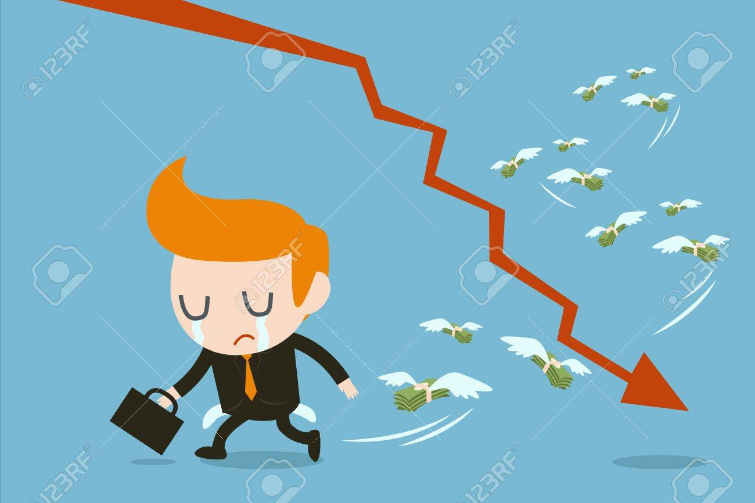
Stop Online Piracy Act (SOPA) -- 2011/2012
Would have made social media companies liable for copyright violations in user-generated content
Could be sued for enormous amounts of money even for small violations

Slide 7
Stop Online Piracy Act (SOPA) -- 2011/2012
SOPA would shift the responsibility from the copyright holder to the social media platform
Companies would have to hire people to review every new post, video, etc.
Prohibitive due to cost and speed -> drive companies out of business

Slide 8
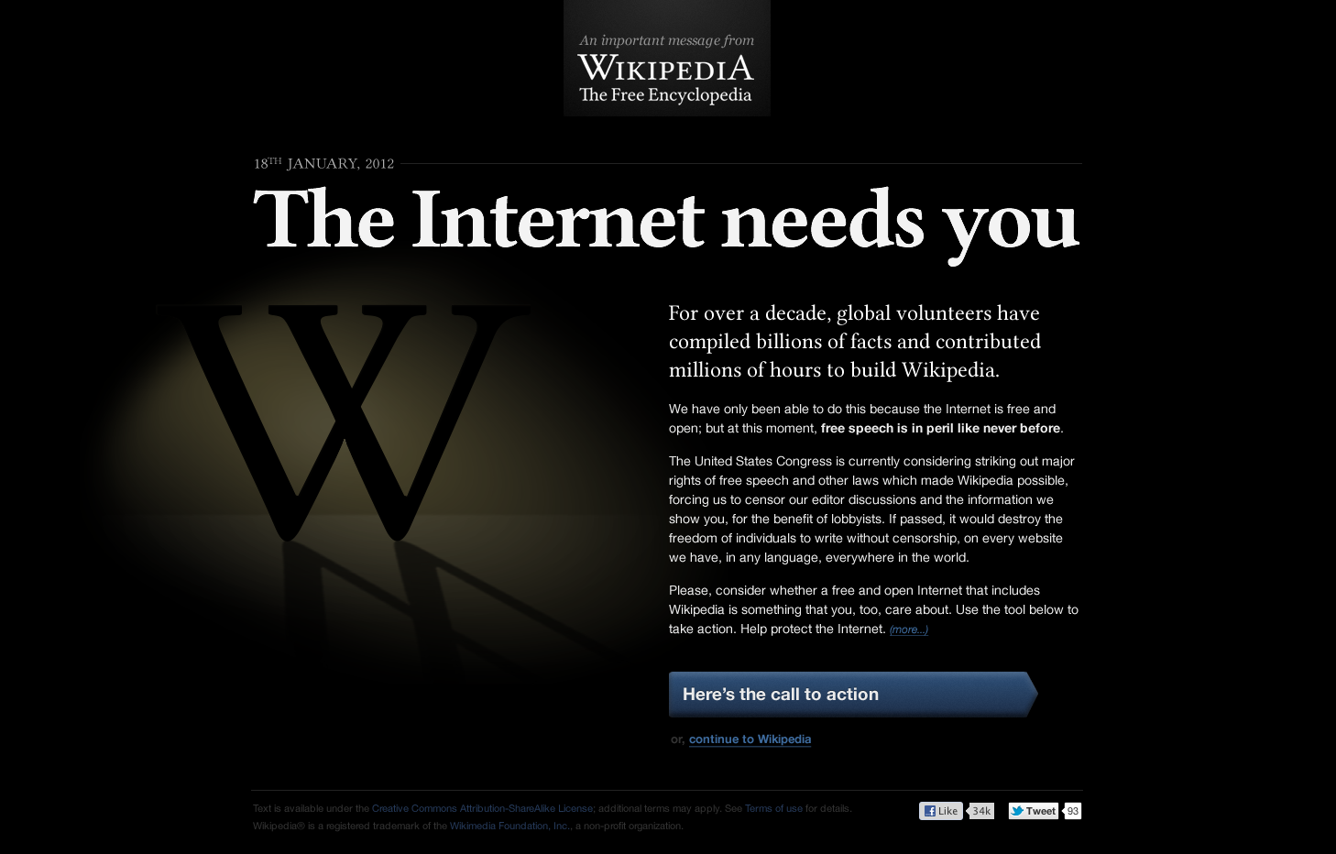
Stop Online Piracy Act (SOPA) -- 2011/2012
Platforms that depended on user-generated content held protests
Users contacted their representatives and senators
SOPA was defeated

Slide 9

Response to SOPA
Platforms wanted to avoid another SOPA-like threat
Adopted approaches for copyright violation detection
Companies use "layered" process
Machine learning tags copyright violations in new content
Reject content predicted to violate copyright; let other content pass
Humans receive and can process appeals from users and copyright violation notices from companies

Slide 10
Response to SOPA
Machine learning is less accurate but can make decisions quickly
Users can still post content almost immediately, while reviewers only see a small fraction of overall content
Reduce copyright infringement but in a sustainable way
Make copyright holders happy

Slide 11

Digital Advertising
Traditional print, TV, and radio advertising can only broadcast to a wide segment of customers
Digital adverting can be customized for each user
More direct feedback on effectiveness of advertising by tracking clicks and purchases

Slide 12
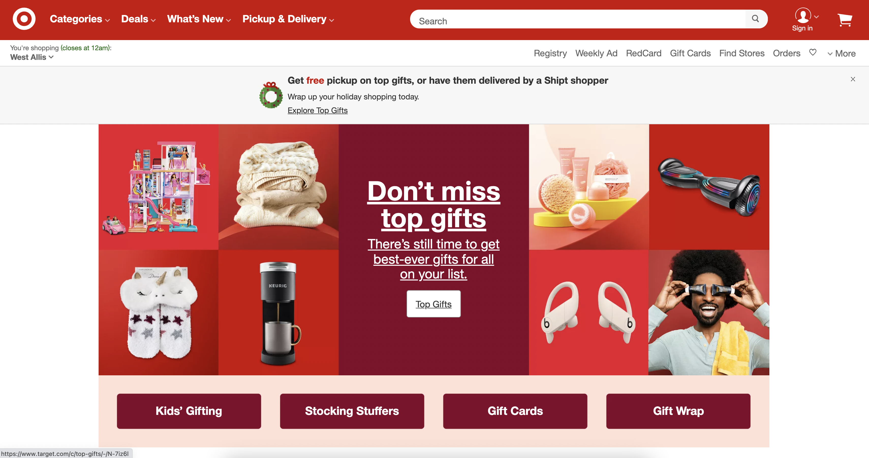
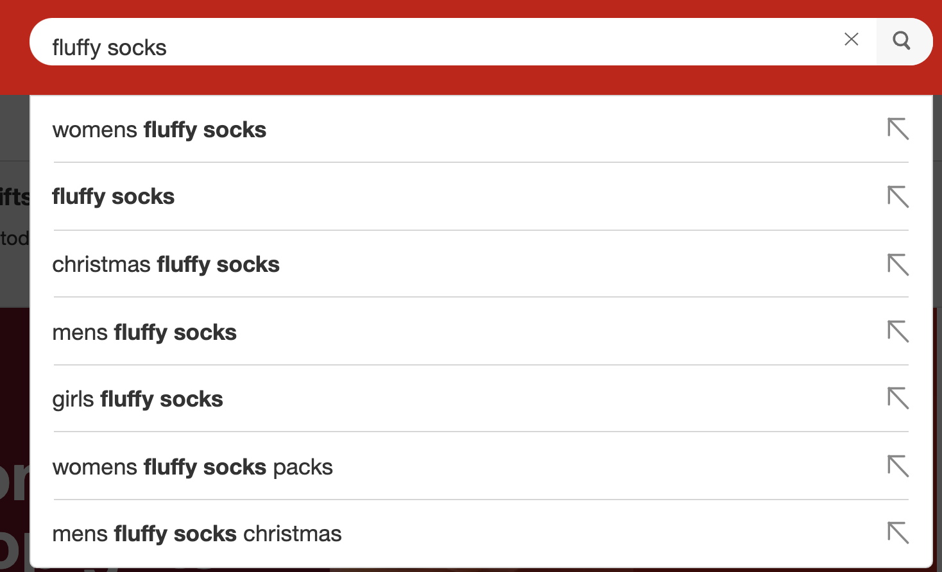
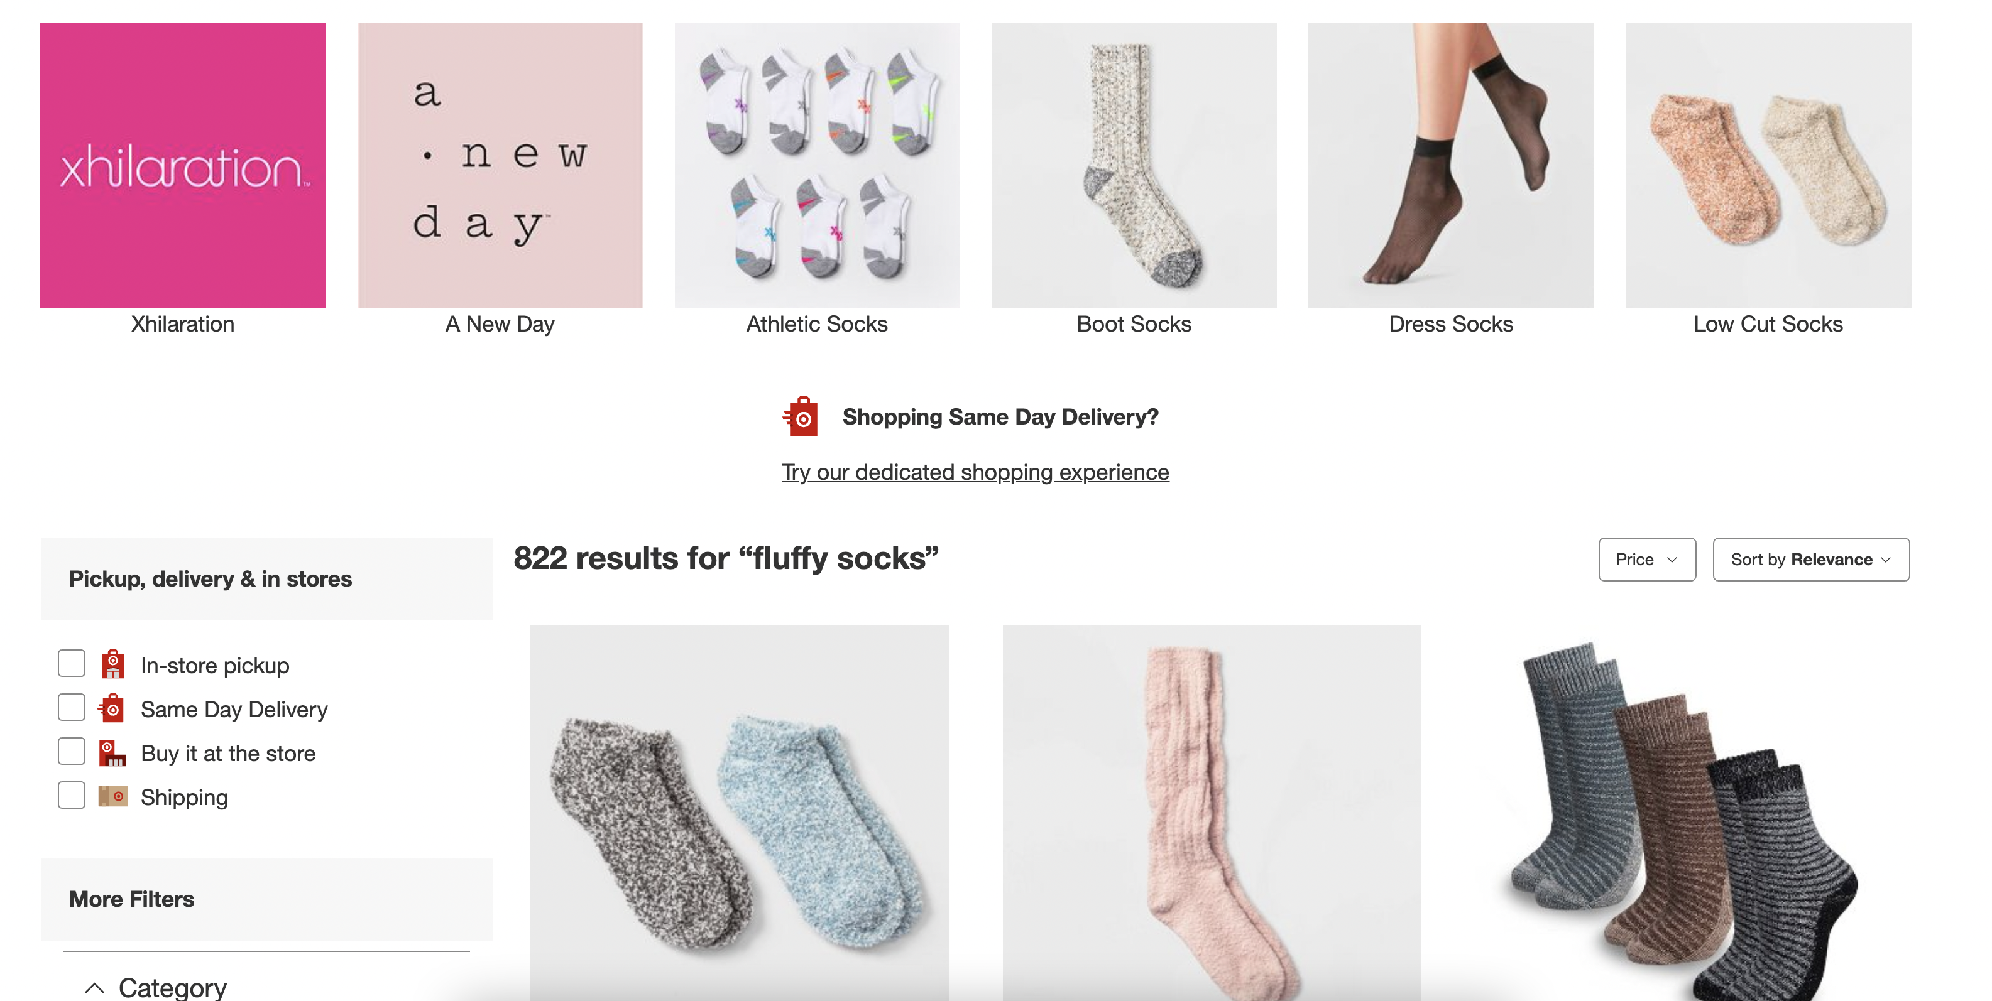
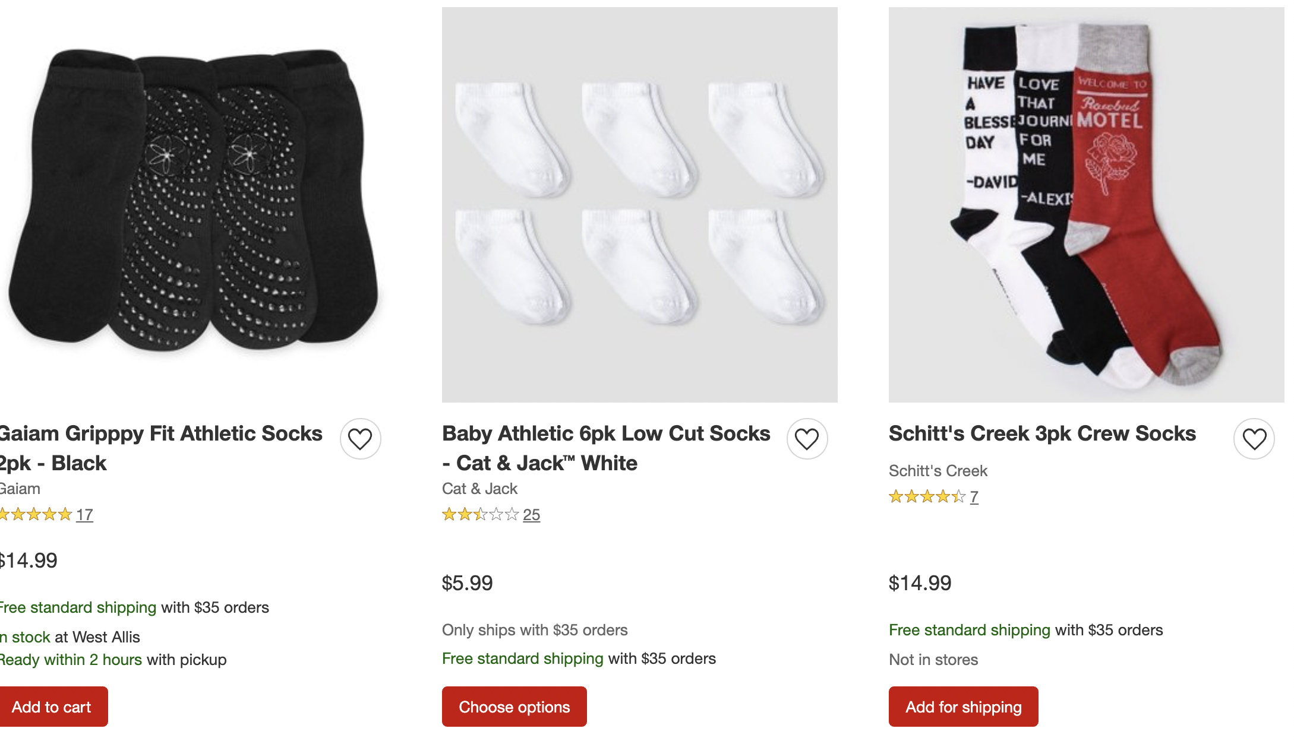
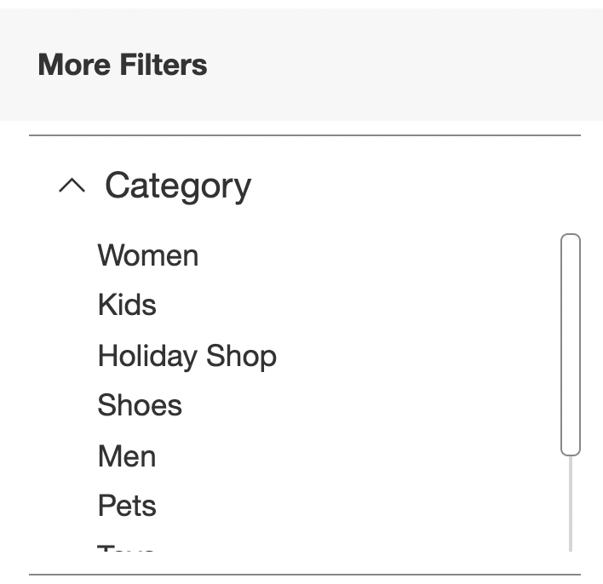
Digital Advertising
Leave, no purchase

Slide 13
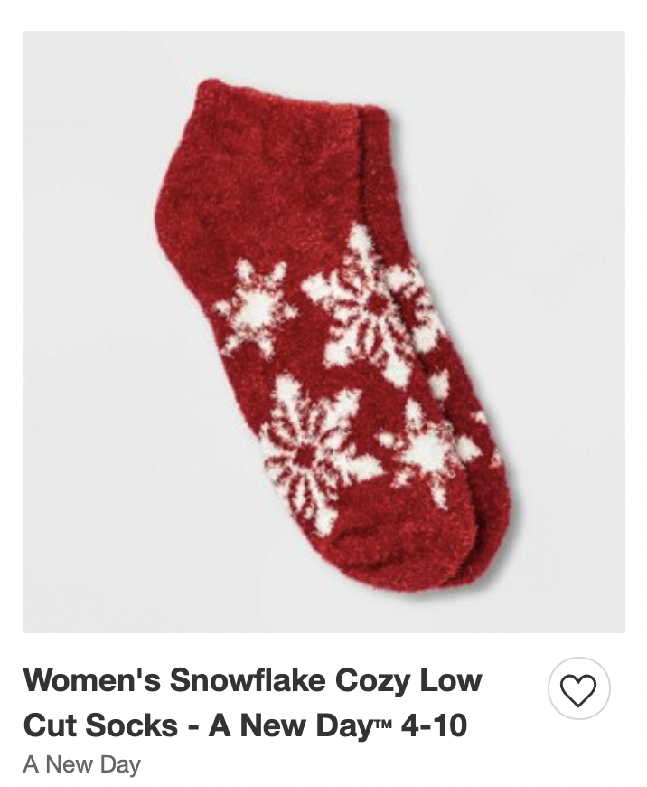
Digital Advertising
Pick up in store
Checkout
Add to Cart
Ship

Slide 14
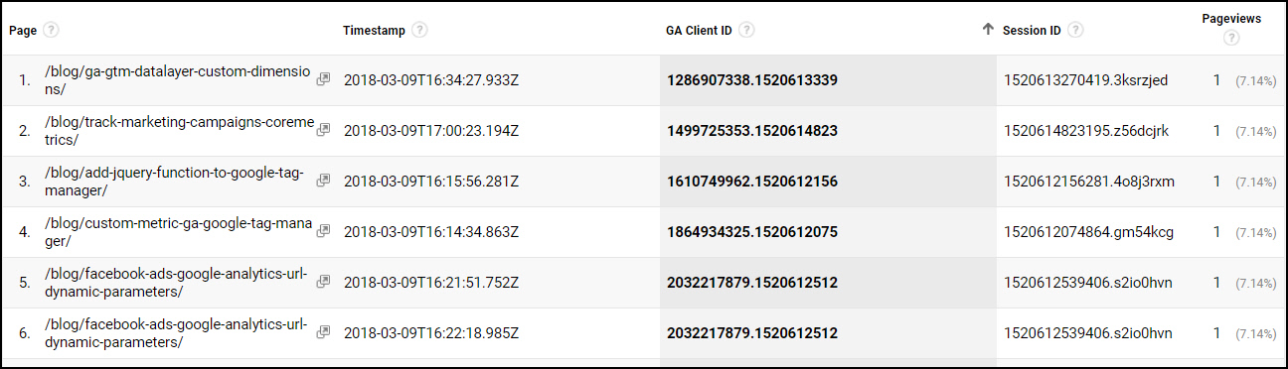
Clickstream Data
https://mixedanalytics.com/blog/quickstart-google-analytics-clickstream-data/

Slide 15
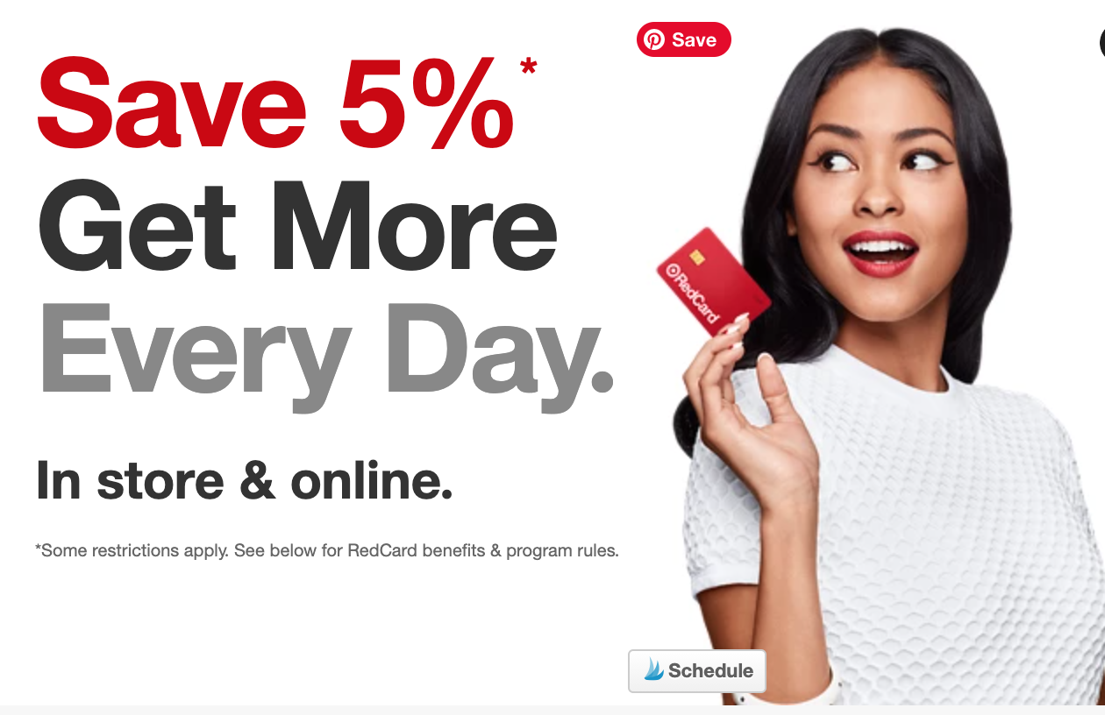
Machine Learning Models
P(purchase|item viewed)
P(purchase again|elapsed time)
P(purchase|other item)

Slide 16
Online Advertising
Return to purchase an item the user looked at
Purchase again (for things like dog food)
Purchase other items

Slide 17
Training and Testing Events
Past
Label

Slide 18
Machine Learning Pipeline

Slide 19
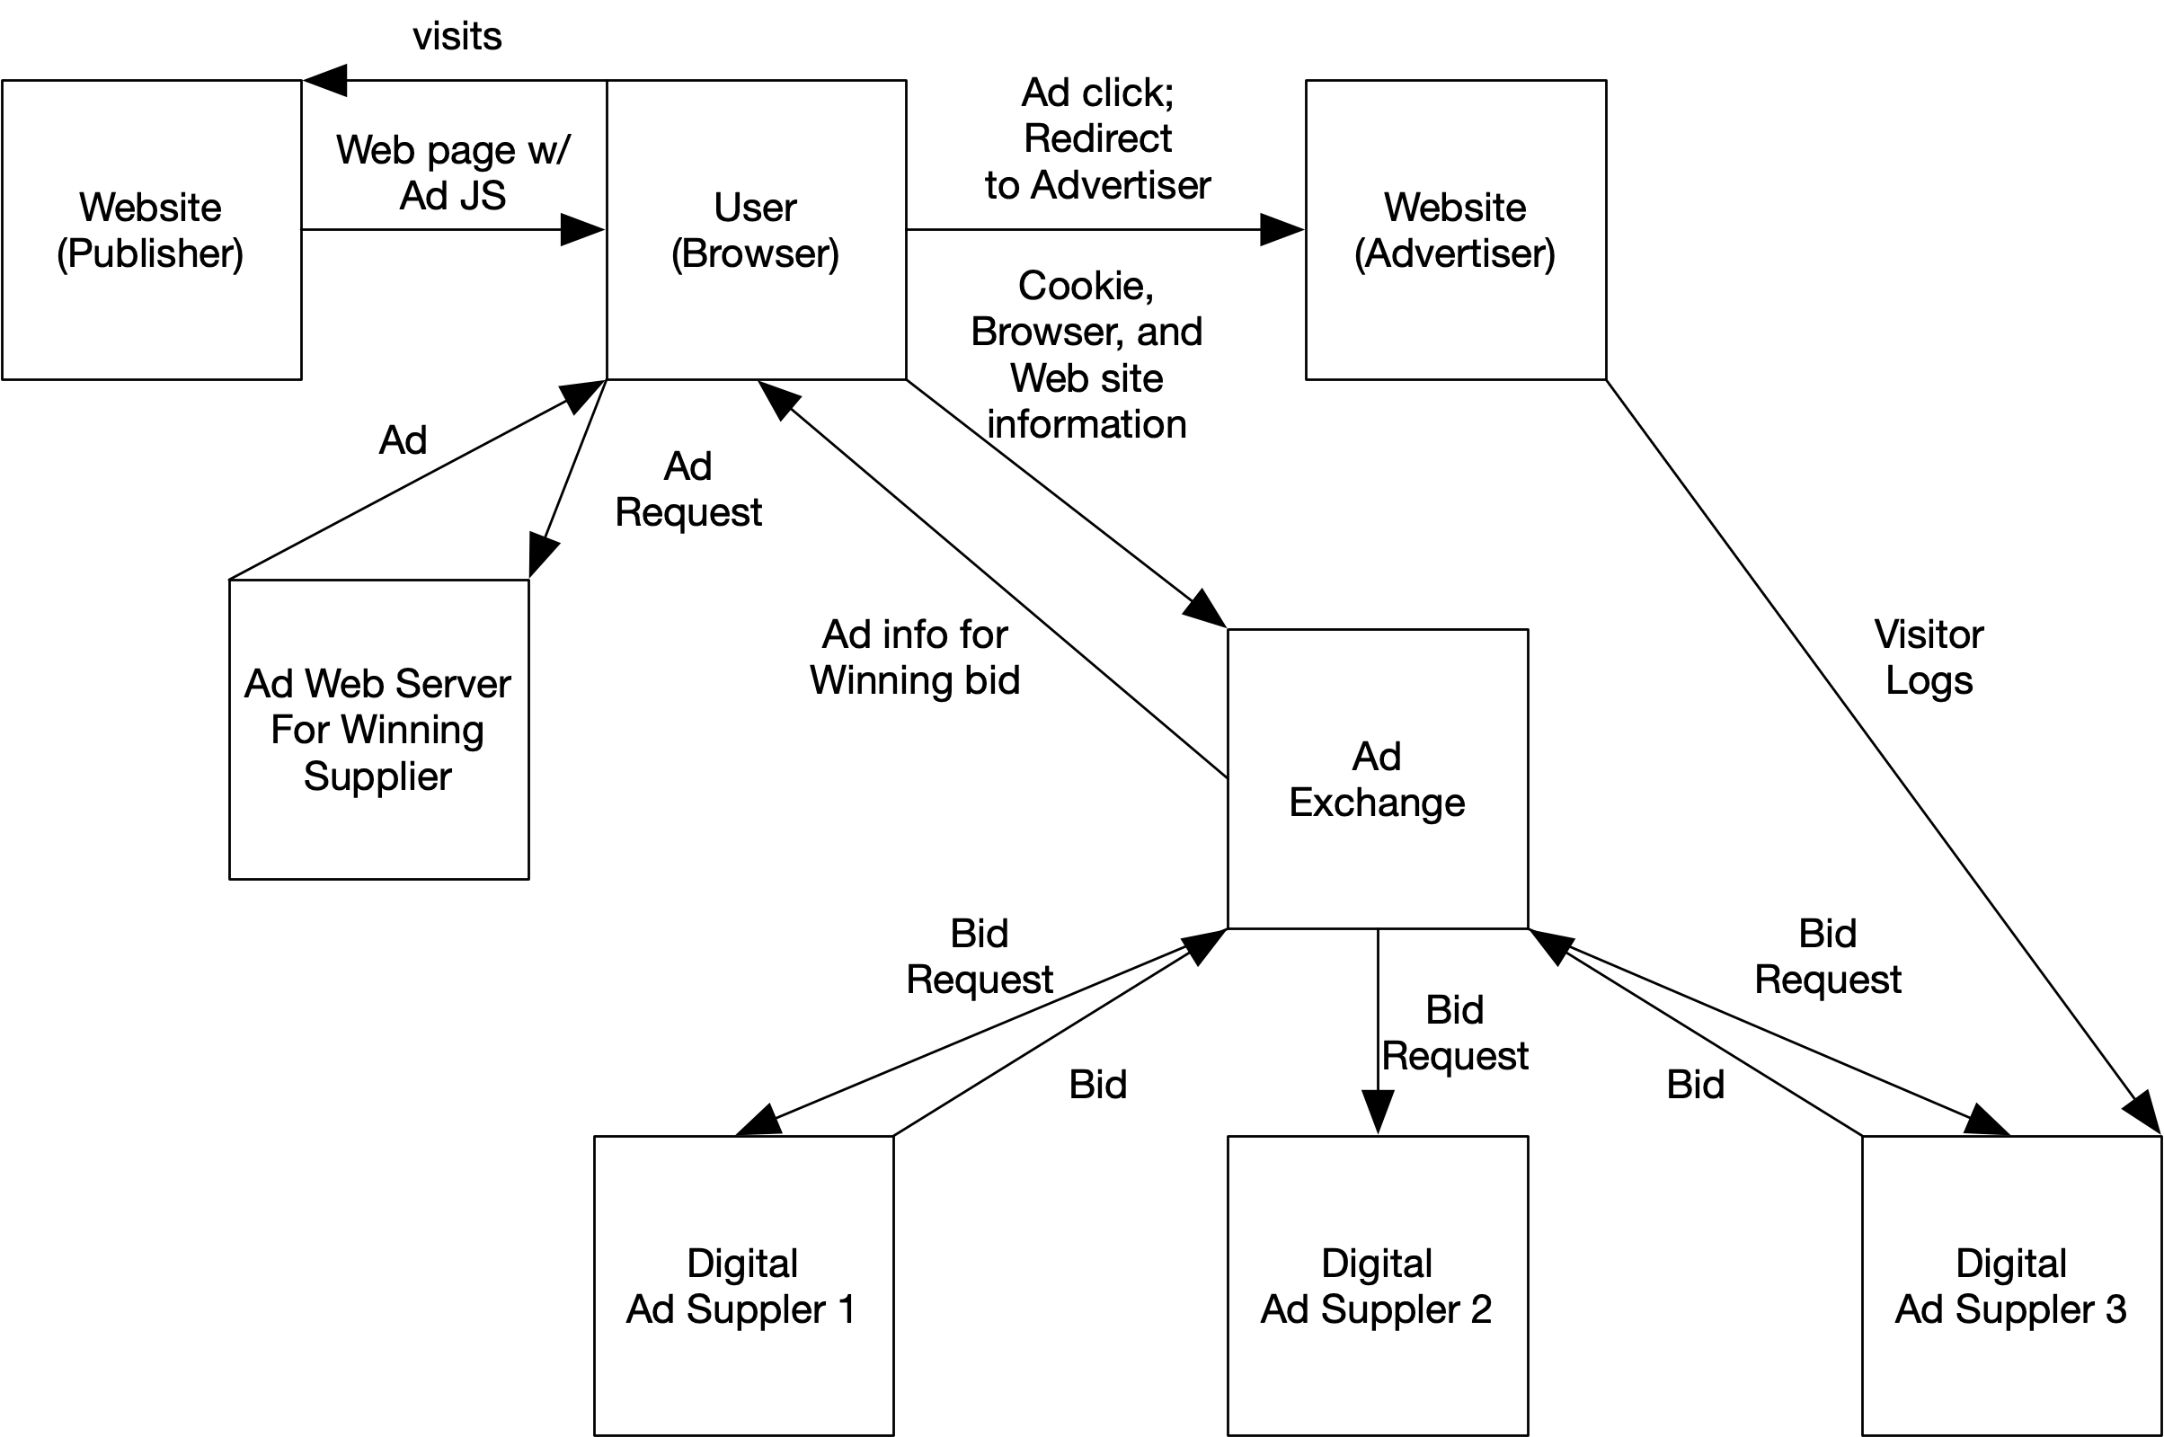
Real-Time Ad Serving

Slide 20
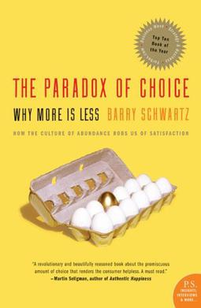
Online Shopping
Online retailers (e.g., Amazon, Target, Walmart, etc.) have massive inventories of items
Far larger than what we can be carried in store
This presents a problem for users: users can be overwhelmed by the choices

Slide 21
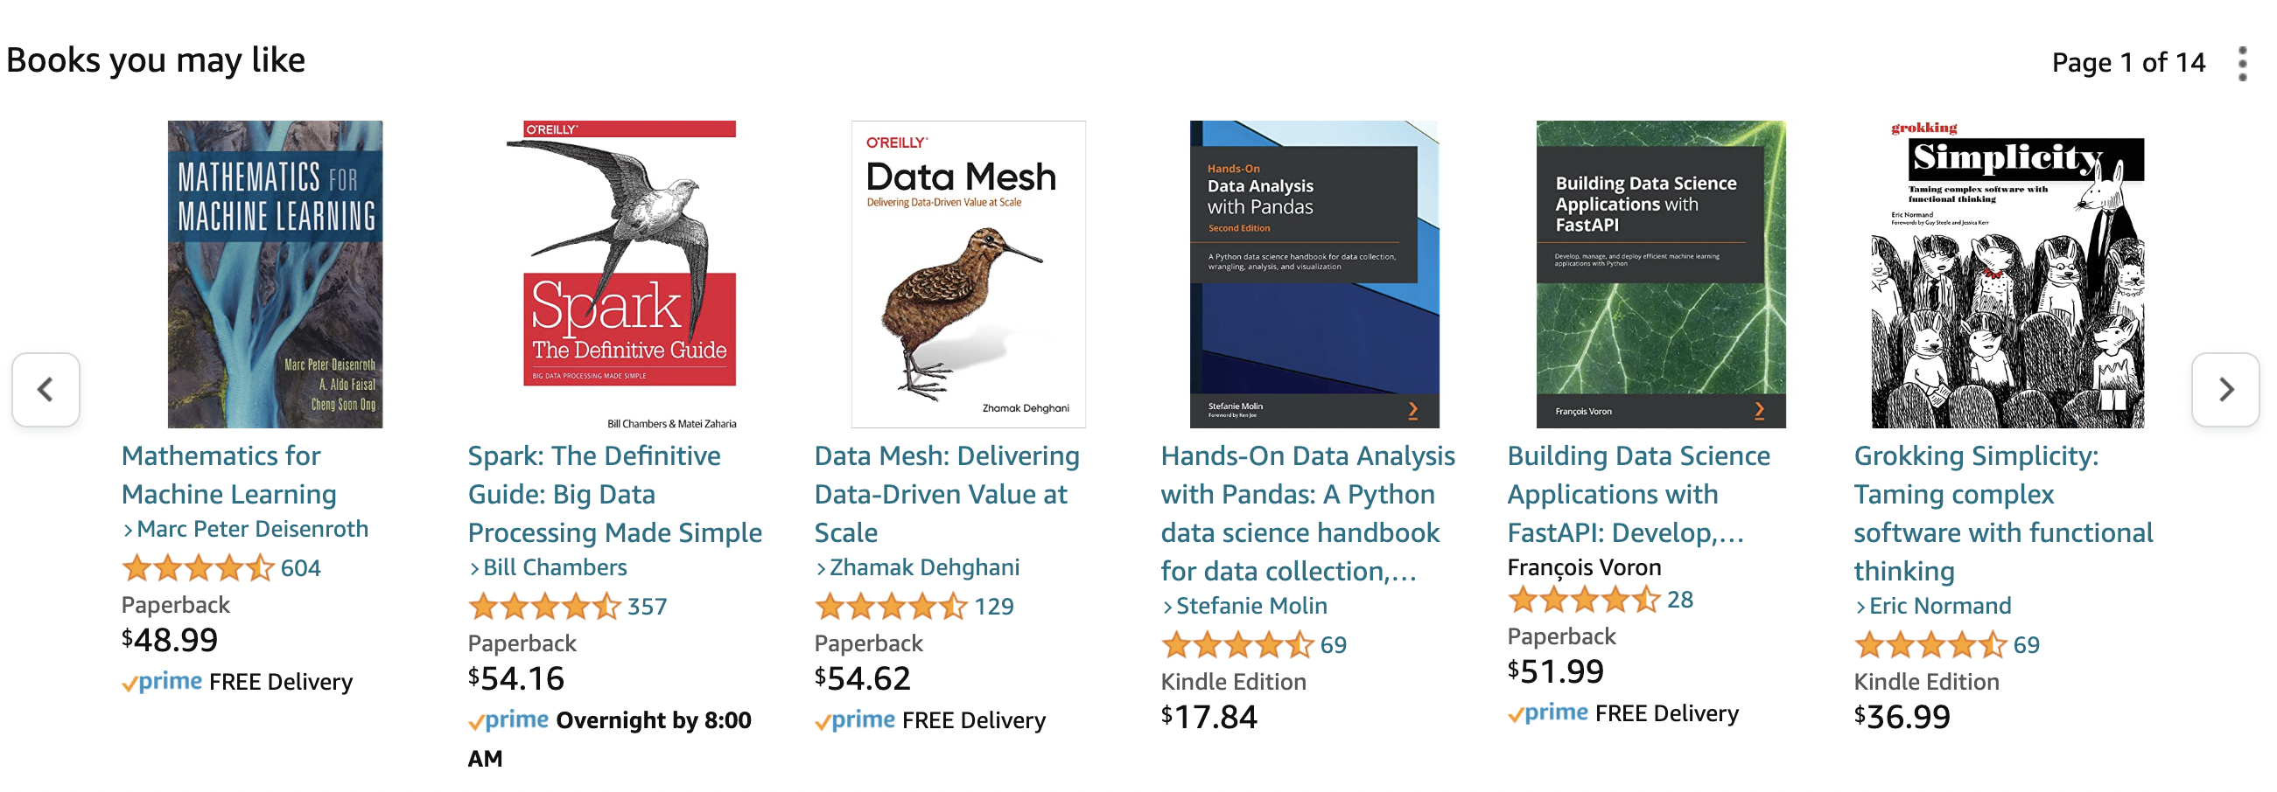
Online Shopping
Online retailers use recommendation systems to help users find items that may be of interest
Hypothesis: if a user looks at an item, it's probably similar to what they are looking for -- high-quality signal

Slide 22

Spotify
Spotify offers free / low-cost streaming of a large catalog of music
Users save money: don't have to buy every album or song individually
Artists get paid per song play
Spotify gets paid by ads or premium (ad-free) memberships

Slide 23
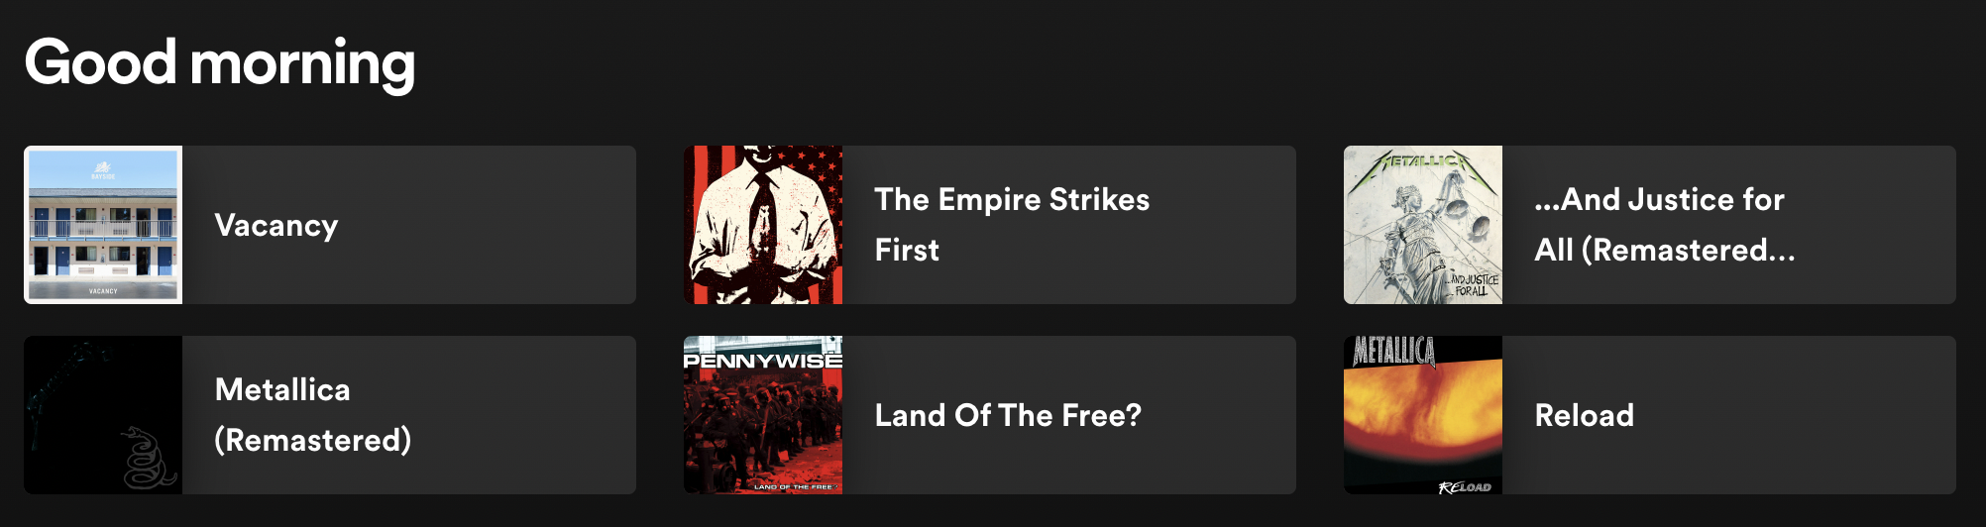
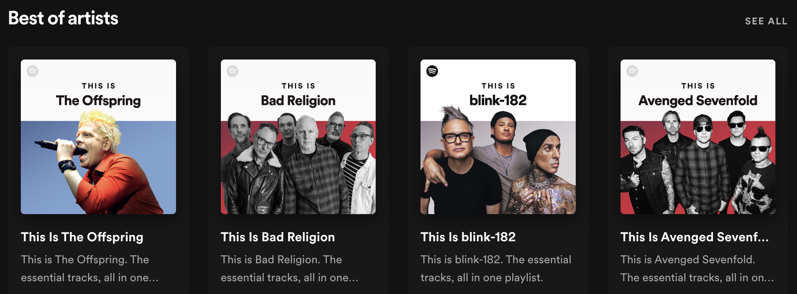
Spotify

Slide 24
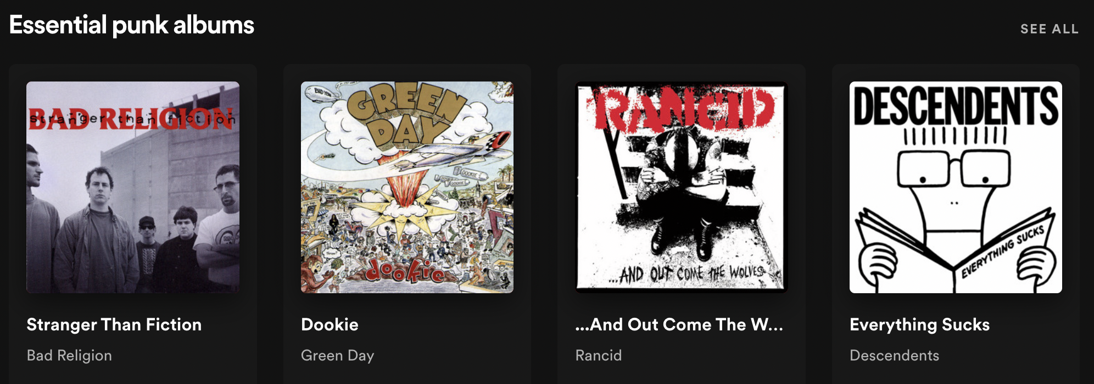
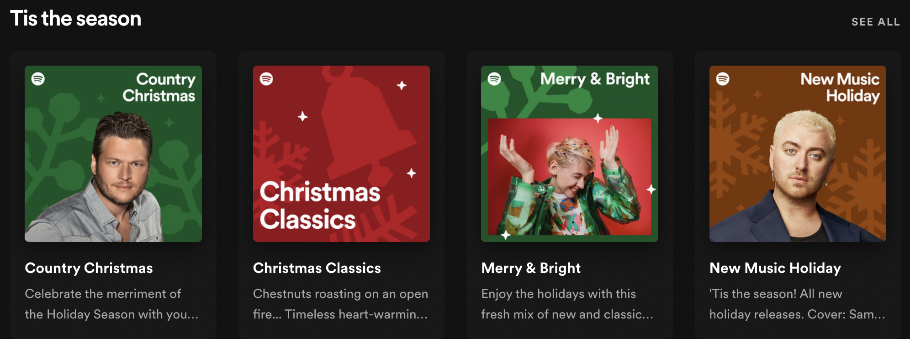
Spotify

Slide 25
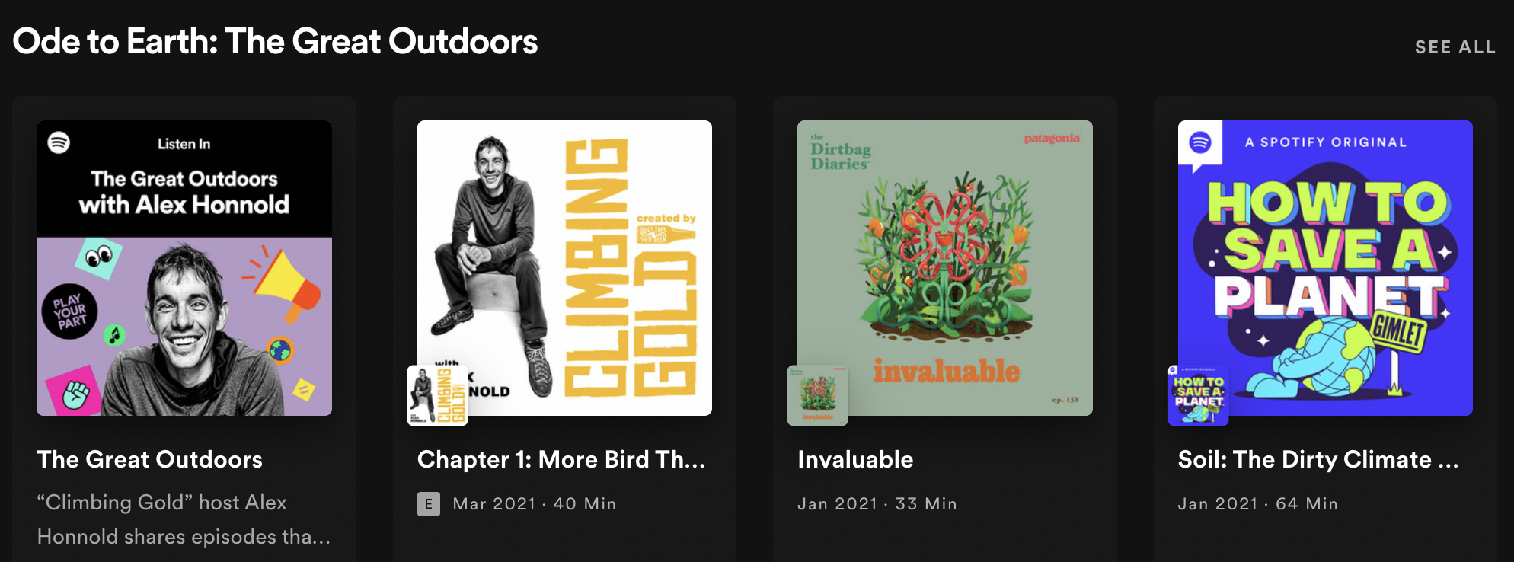
Spotify

